Slide 1


Talles Oliveira Vilela
May 2025

Slide 2

Outline
Executive Summary
Results
Conclusion
Introduction
Methodology

Slide 3



Executive Summary
Objective: predicting the landing of first stage of Falcon 9 rockets using SpaceX open data to estimate launch costs
Methodologies
Results
Data Collection
Data Wrangling
EDA using visualization and SQL
Dashboards with Plotly and Dash
Build Classification Models
Insights draw from EDA
Launch Sites proximities analysis
Features analysis with interactive Dashboards
Model constructions and comparison

Slide 4



Introduction
In the commercial space age has begun – space travel is becoming more accessible
SpaceX can reduces launch costs by reusing the first stage of its Falcon 9 rocket
A successful landing of the first stage greatly affects the launch price

Slide 5



Introduction
Predicting first stage landing is key to estimating launch costs. This can be achieved by:
Performing exploratory data analysis
Building dashboards to support decision-making
Constructing and improving Machine Learning Models

Slide 6

Section 1

Slide 7
Methodology
Executive Summary
Data collection methodology:
How data was collected
Perform data wrangling
How data was processed
Perform exploratory data analysis (EDA) using visualization and SQL
Perform interactive visual analytics using Folium and Plotly Dash
Perform predictive analysis using classification models
Build, improvement, evaluate classification models

Slide 8




Data Collection
Open-source API + Web Scraping (Wikipedia)
Structured and unstructured data sources
Focus on SpaceX missions data
JSON responses with nested keys

Slide 9

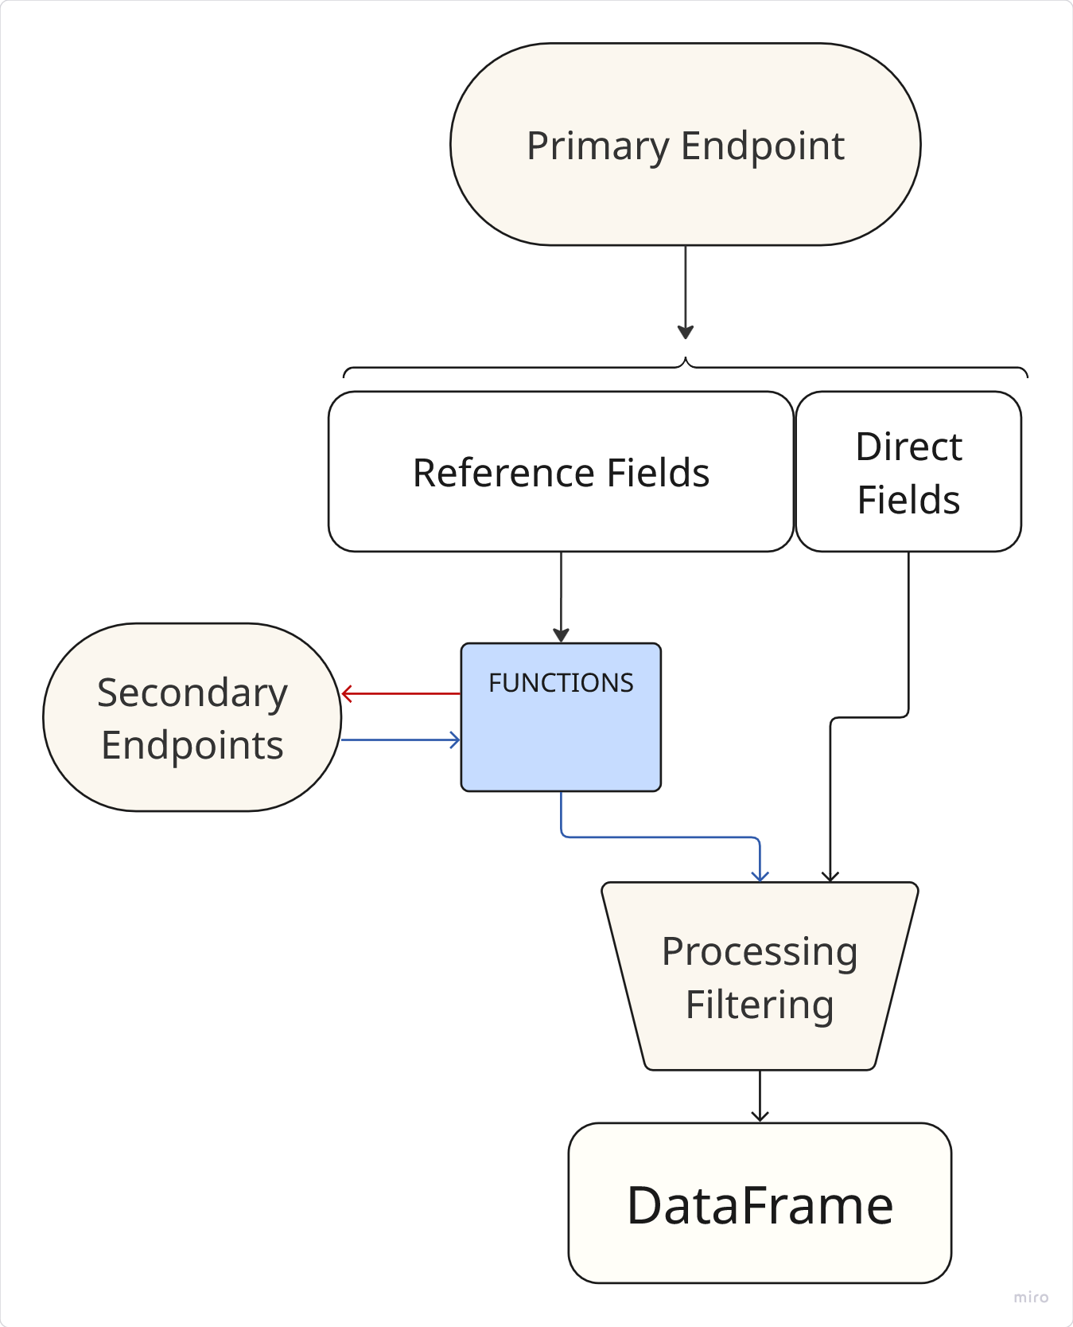

Data Collection – SpaceX API
Open-source, community-maintained, not officially affiliated with SpaceX
Function-based Extraction
Endpoint Structure:
https://api.spacexdata.com/v4/launches/past: primary endpoint
Direct fields: “flight_number”, “date_utc”
Reference fields for further queries: “rocket”, “payloads”, “cores” and “launchpad”
GitHub URL

Slide 10
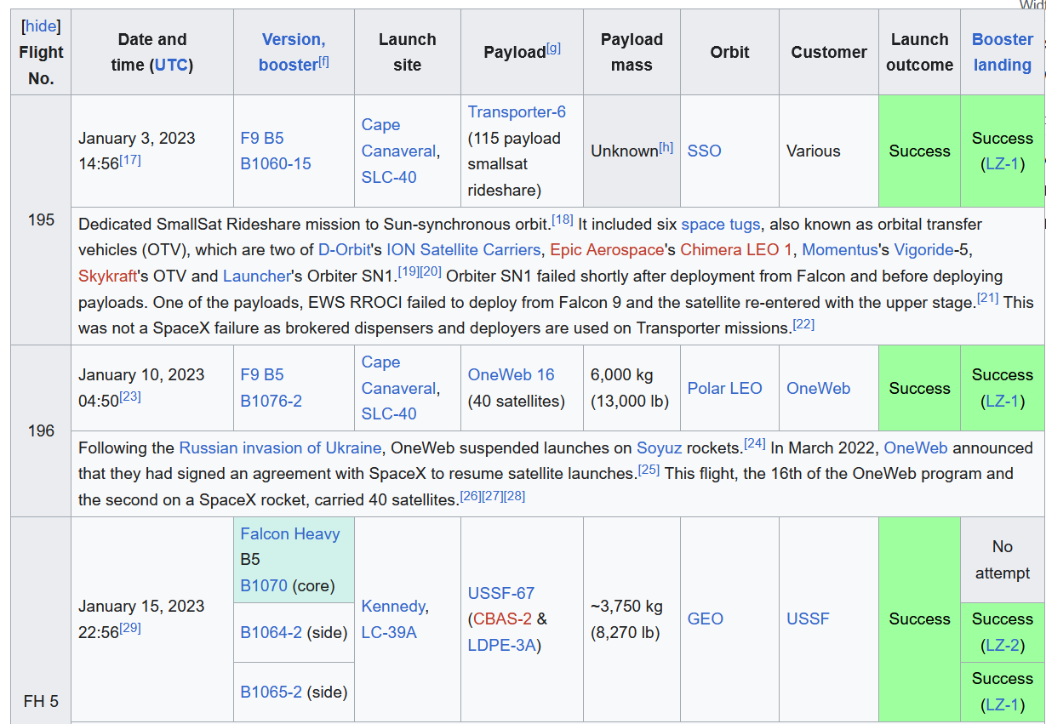



Data Collection - Scraping
Target: https://en.wikipedia.org/wiki/List_of_Falcon_9_and_Falcon_Heavy_launches
Structured data
Beautiful Soup
soup = BeautifulSoup(request.content, "html.parser")

Slide 11

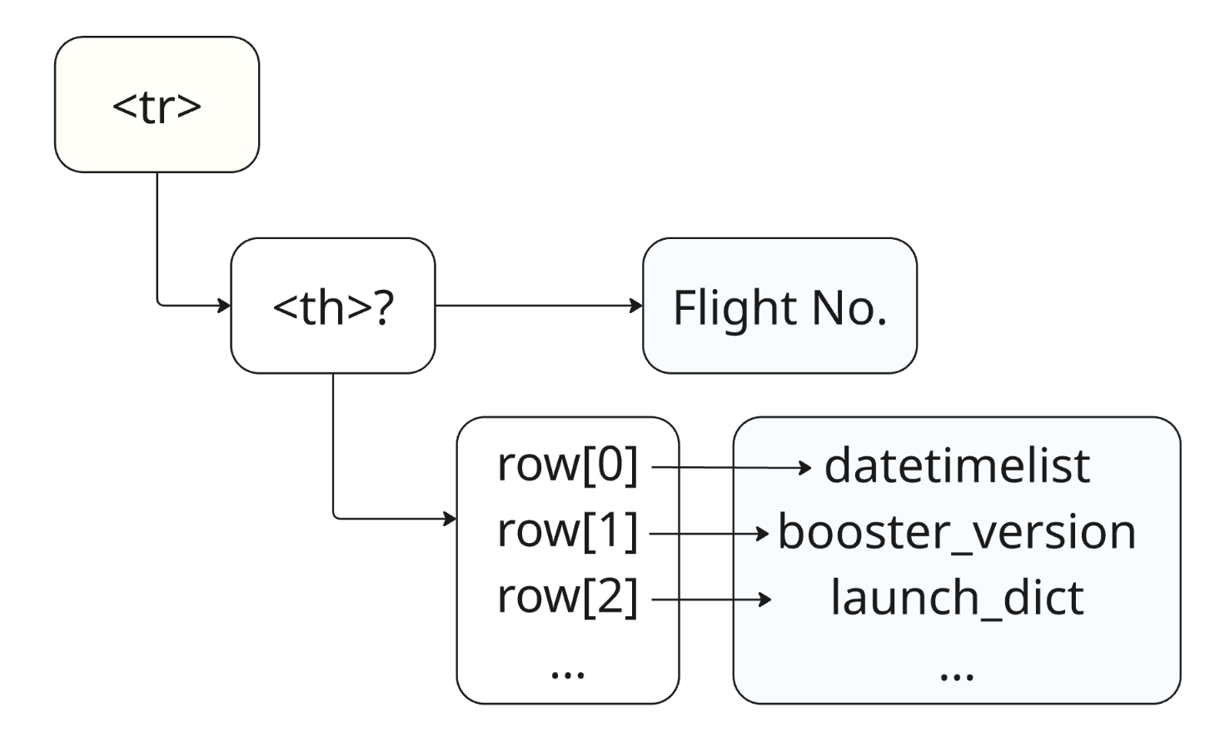
Data Collection - Scraping
Iterations with “soup” elements
GitHub URL

Slide 12

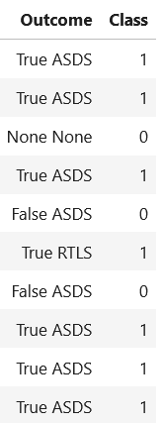
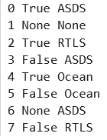

Data Wrangling
Create a one-hot encoding for map “Outcome” values
“False” = bad outcomes
GitHub URL

Slide 13


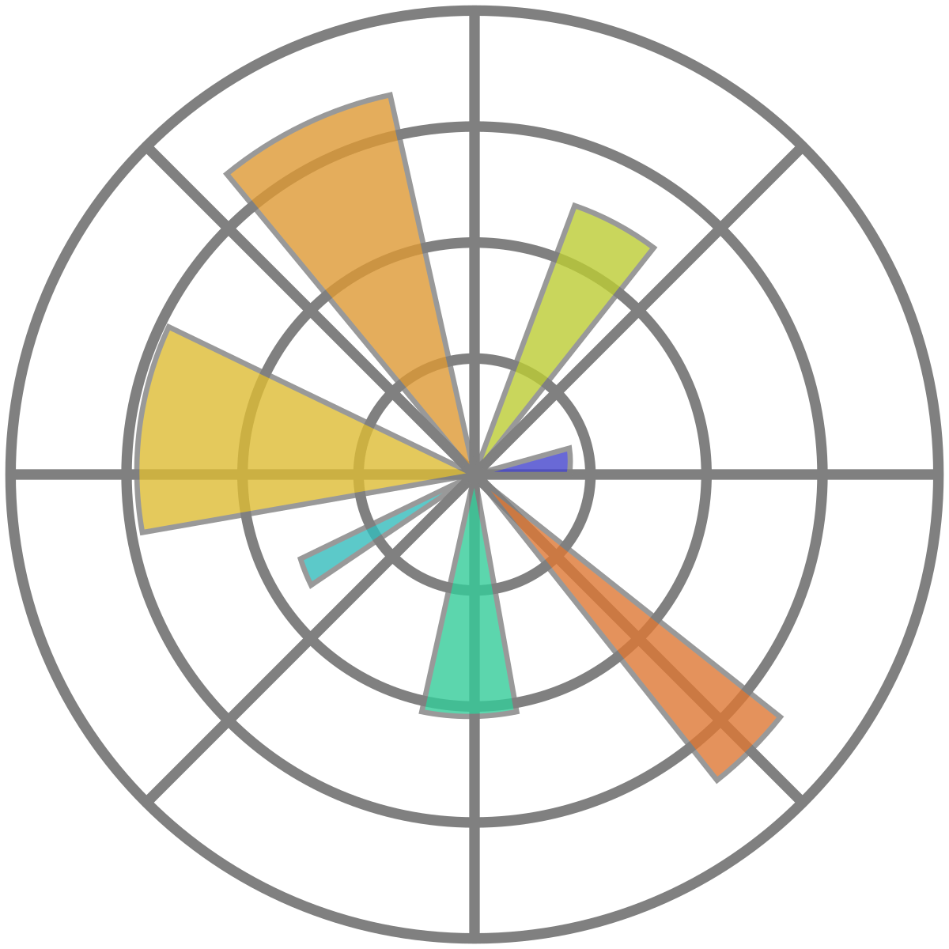
EDA with Data Visualization
Using Seaborn and Matplotlib functions to understand the relationship between the features
High-level interface for drawing attractive statistical graphics
Granular control over plot elements
GitHub URL

Slide 14




EDA with SQL
Efficient extraction, filtering, and aggregation of data
Jupyter and SQL: magic functions
“%sql” and “%%sql”
GitHub URL

Slide 15
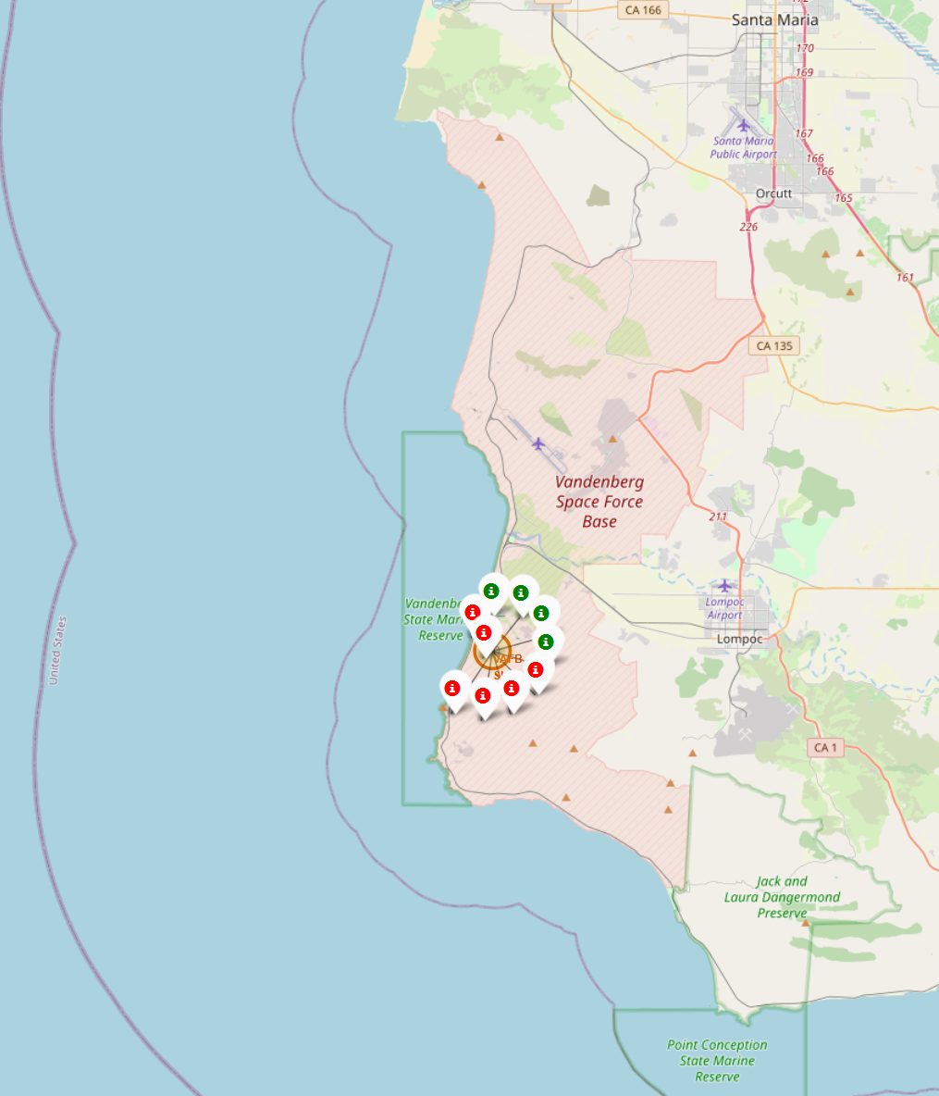



Build an Interactive Map with Folium
Geospatial Analysis of Launch Outcomes using Folium
Map launch sites, highlighting successes and failures
Tools:
Circles
Markers
Cluster
Lines
GitHub URL

Slide 16




Build a Dashboard with Plotly Dash
Interactions allow you to quickly change the way you correlate data
Evaluate how the predicted variable is influenced by:
Launch Sites
Payload Mass
Booster Version Category
GitHub URL

Slide 17




Predictive Analysis (Classification)
Preprocessing:
Target variable: Y = ‘Class’
Features (x) scaled using StandarScaler()
Data split using train_test_split function
Model Comparison – Full Pipeline Applied to:
Logistic Regression
Support Vector Machine (SVM)
Decision Tree
K-Nearest Neighbors (KNN)
Validation and Evaluation
Validation by Accuracy
Evaluation by Accuracy and Confusion Matrix with the test data
Model Tuning
Paramete rs definition for apply GridSearch Cross Validation with 10 folds
GitHub URL

Slide 18



Results
Exploratory data analysis results
Interactive analytics demo in screenshots
Predictive analysis results

Slide 19

Section 2

Slide 20
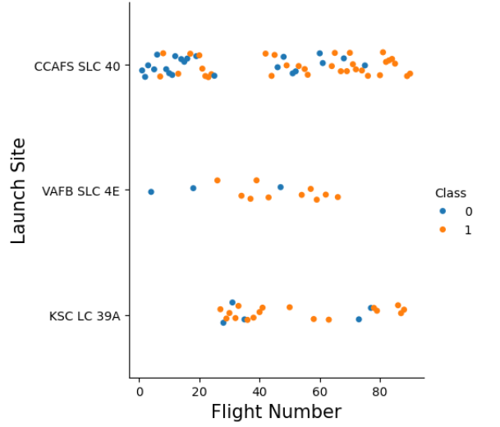


Flight Number vs. Launch Site
In general, success seems to be related to increasing Flight Number
CCAFS SLC 40 had low success rates in the first attempts

Slide 21
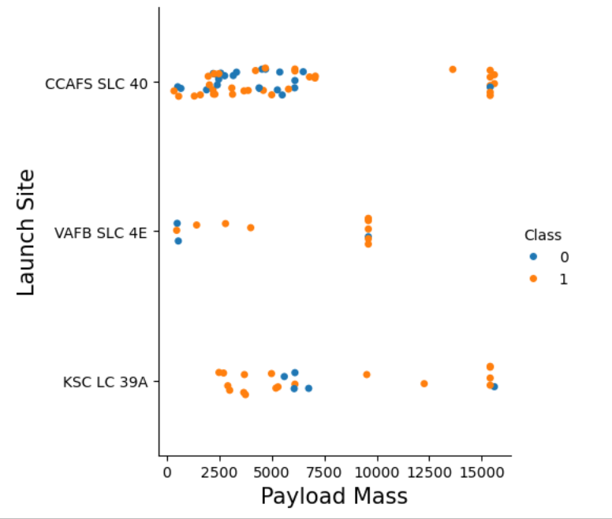



Payload vs. Launch Site
VAFB SLC 4E launch site there are no rockets launched for heavy payload mass
CCAFS SLC 40 performed well with heavy payloads
Not important correlation between Payload Mass and success observed

Slide 22
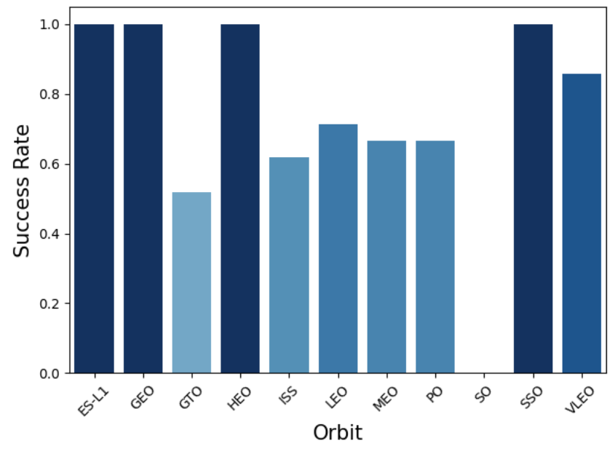



Success Rate vs. Orbit Type
ES-L1, GEO, HEO and SSO reached 100% of success rate
No launch to SO orbit has been successful
It is important to consider that these values where strongly influenced by the launch count, that is equal 1.
(Exception: SSO = 5 launches)

Slide 23
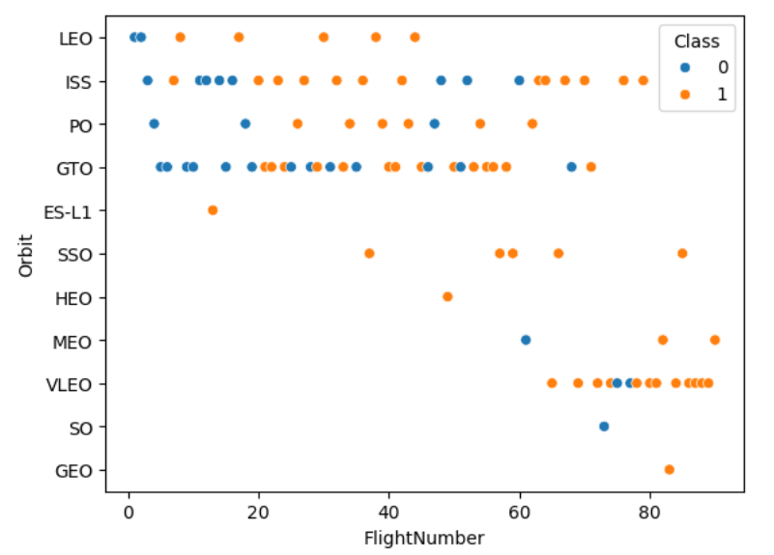


Flight Number vs. Orbit Type
In the LEO and PO orbits, success seems to be related to the number of flights
There seems to be a tendency for failures and successes to occur consecutively, when considering launches into the same orbit

Slide 24
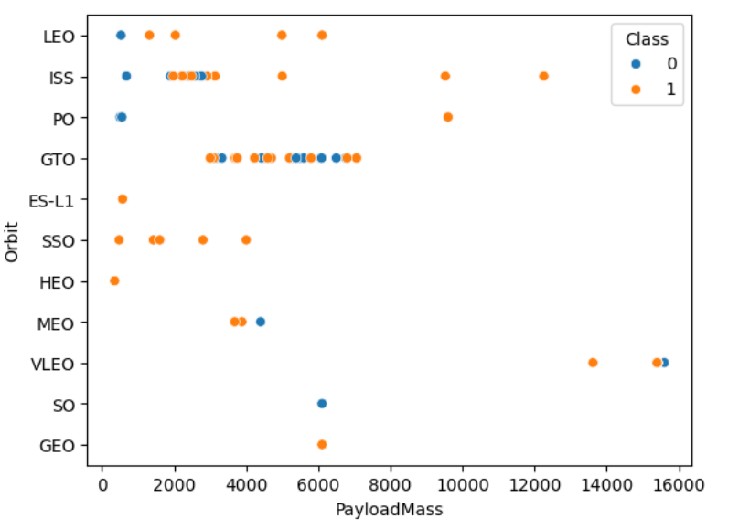


Payload vs. Orbit Type
For heavy payloads, performance is better in PO, LEO and ISS missions
GTO shows similar outcomes for both low and high payloads

Slide 25
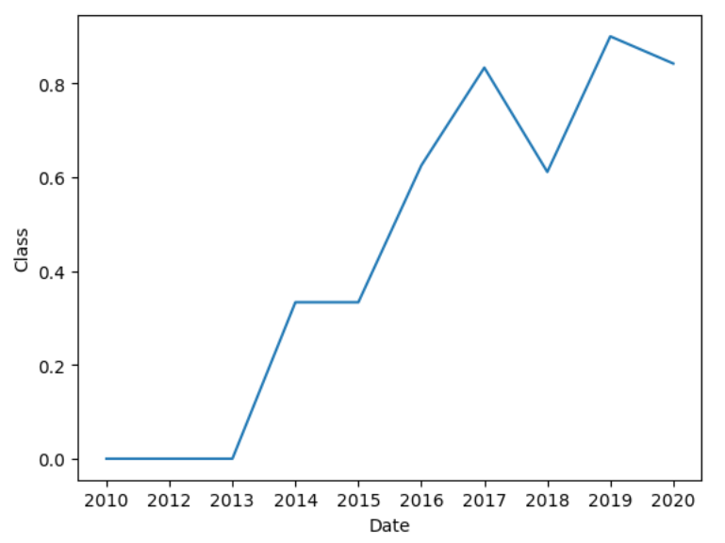

Launch Success Yearly Trend
Timeline graph demonstrates a trend of improved performance over the years

Slide 26



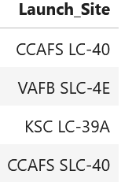
All Launch Site Names
Discovering names of the launch sites for feature undestanding
%sql SELECT DISTINCT Launch_Site FROM SPACEXTABLE

Slide 27

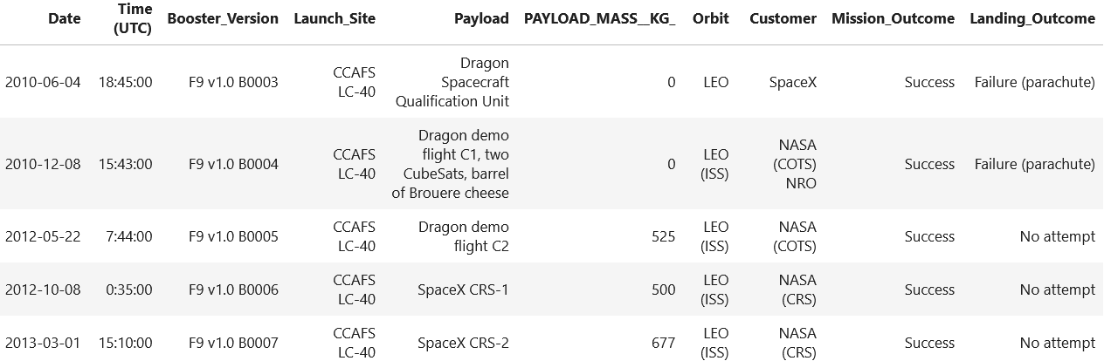
Launch Site Names Begin with 'CCA'
Using query capabilities to check similarity between Launch Site names
%%sql SELECT * FROM SPACEXTABLE WHERE Launch_Site LIKE 'CCA%' LIMIT 5

Slide 28

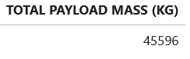
Total Payload Mass
Aggregate queries and using filters with ‘WHERE’ to find the total Payload Mass for ‘Nasa (CRS)’ customer
%%sql SELECT SUM(PAYLOAD_MASS__KG_) AS 'TOTAL PAYLOAD MASS (KG)' FROM SPACEXTABLE WHERE Customer = 'NASA (CRS)'

Slide 29

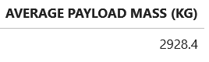
Average Payload Mass by F9 v1.1
Aggregate queries for calculating the average payload mass carried by booster version F9 v1.1
%%sql SELECT AVG(PAYLOAD_MASS__KG_) AS 'AVERAGE PAYLOAD MASS (KG)' FROM SPACEXTABLE WHERE Booster_Version == 'F9 v1.1'

Slide 30

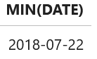
First Successful Ground Landing Date
Finding the first success by filtering ‘Lainding_Outcome’ equal ‘Success’ and selecting the minor result
%%sql SELECT MIN(DATE) FROM SPACEXTABLE WHERE Landing_Outcome = 'Success’ ORDER BY DATE ASC

Slide 31

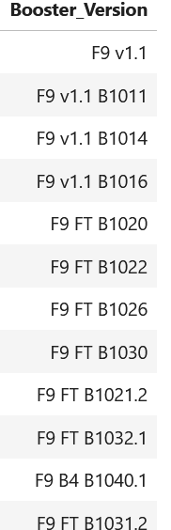
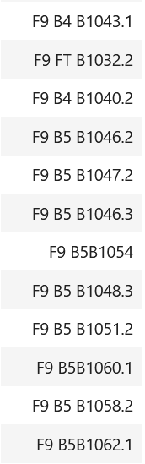
Successful Drone Ship Landing with Payload between 4000 and 6000
Using the WHERE clause to filter the Payload Mass, and the DISTINCT clause to display only one entry per ‘Booster Version
%%sql SELECT distinct Booster_Version FROM SPACEXTABLE WHERE PAYLOAD_MASS__KG_ BETWEEN 4000 AND 6000

Slide 32

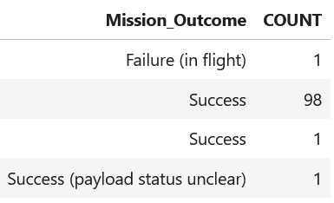
Total Number of Successful and Failure Mission Outcomes
Using COUNT() to display how many times each MISSION_OUTCOME appears
%%sql SELECT Mission_Outcome, COUNT(*) as COUNT FROM SPACEXTABLE GROUP BY Mission_Outcome

Slide 33

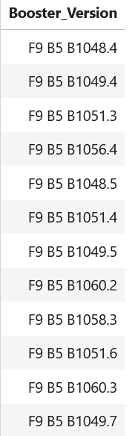
Boosters Carried Maximum Payload
Using subqueries for nested queries
%%sql SELECT distinct Booster_Version FROM SPACEXTABLE WHERE PAYLOAD_MASS__KG_ = (SELECT MAX(PAYLOAD_MASS__KG_) FROM SPACEXTABLE)

Slide 34

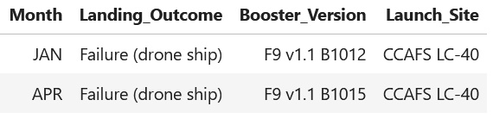
2015 Launch Records
Mapping values using the ‘CASE WHEN’ clause:
e.g. WHEN ‘01’ THEN ‘JAN’ to convert numeric months to abbreviations

Slide 35

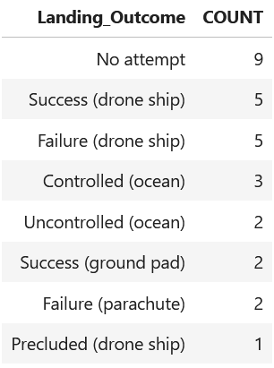
Rank Landing Outcomes Between 2010-06-04 and 2017-03-20
Filtering records by date range and using GROUP BY with COUNT() to show the number of landings for each Landing_Outcome, ordered from most to least frequent.
%%sql SELECT Landing_Outcome, Count(*) AS COUNT FROM SPACEXTABLE WHERE Date BETWEEN '2010-06-04' and '2017-01-20' GROUP BY Landing_Outcome ORDER BY COUNT DESC

Slide 36

Section 3

Slide 37
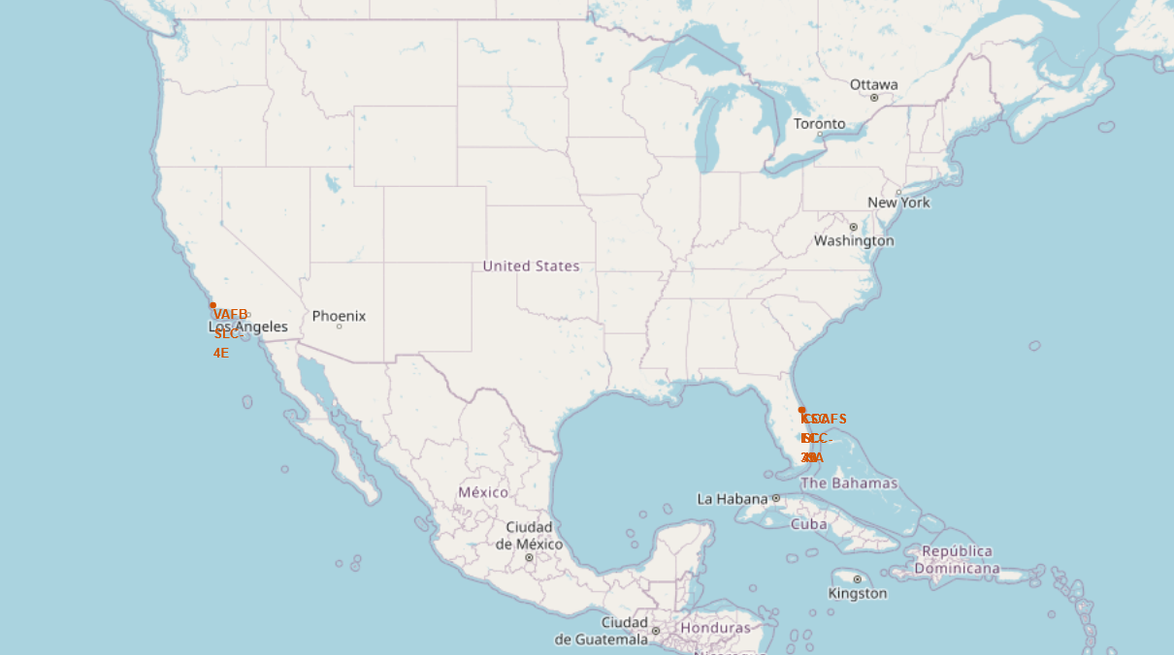

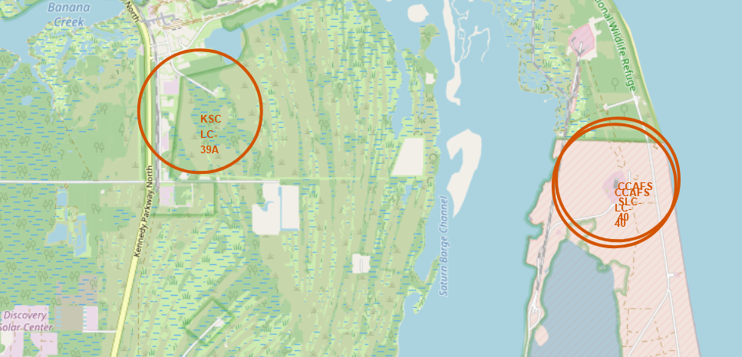

Geospatial Visualization of Lauch Sites
Relevant geographic pattern findings of launch sites beyond the dataset:
Closeness to the Equator
Takes advantage of Earth’s rotational speed
Proximity to coasts
Reduce risk and favor safer outcomes

Slide 38
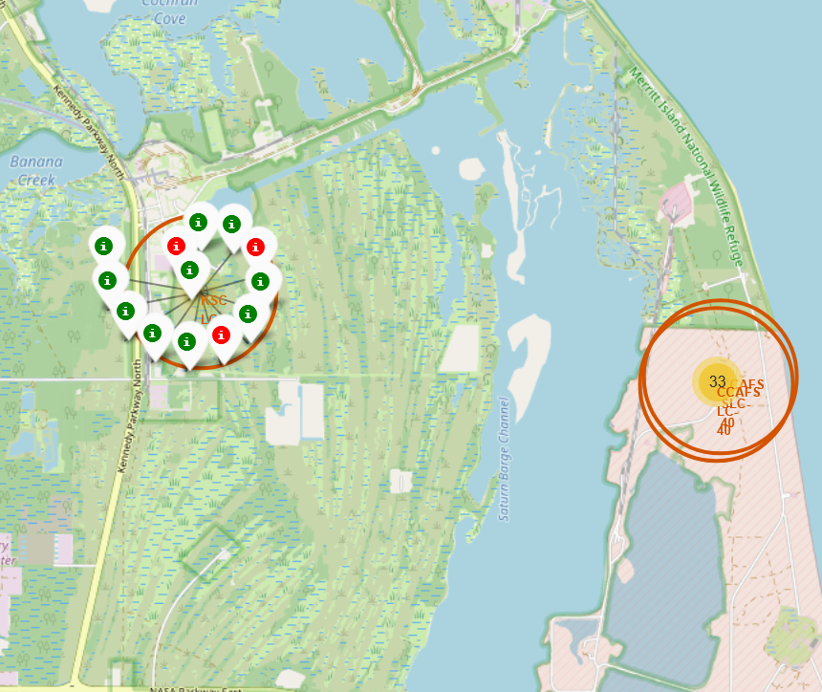


Color-labeled launch outcomes
Quick and interactive visual identification of landing successes and failures
Clear sense of success vs. failure proportions

Slide 39
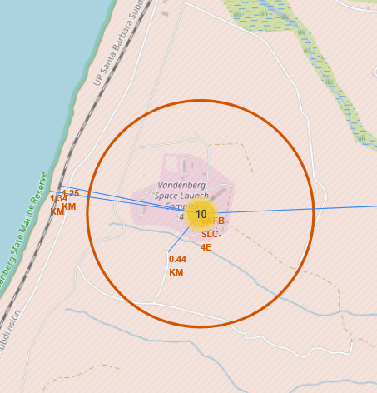





Proximities Analysis
Exploration of geographic elements near launch sites
Close to the coast
13.98 KM
Safety
Far from cities
Relatively close to highways and railways
Access

Slide 40

Section 4

Slide 41
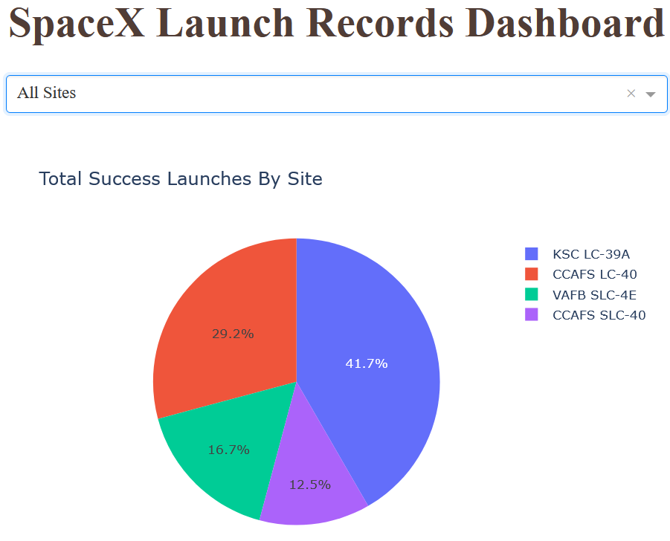


Success Rate Pie Chart
Evaluate how each Launch Site contributes to the predicted variable
CCAFS LC-40 and KSC LC 39-A together account for over 70% of successful launches

Slide 42
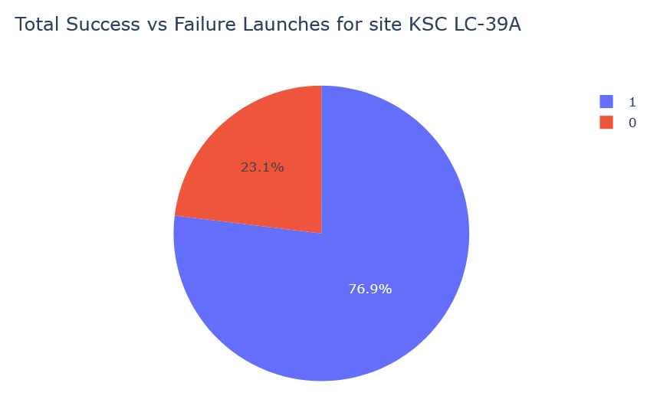


Individual Success Rate for Each Launch Site
View the success rate for each individual Launch Site
KSC LC-39A achieved the highest rate in its launches

Slide 43

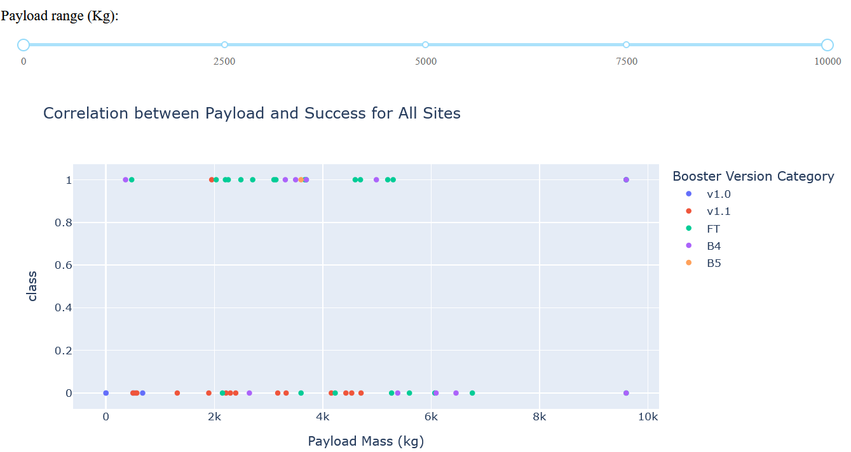
Booster Version Category X Payload Mass
How different Booster Version Categories performance over Payload ranges

Slide 44

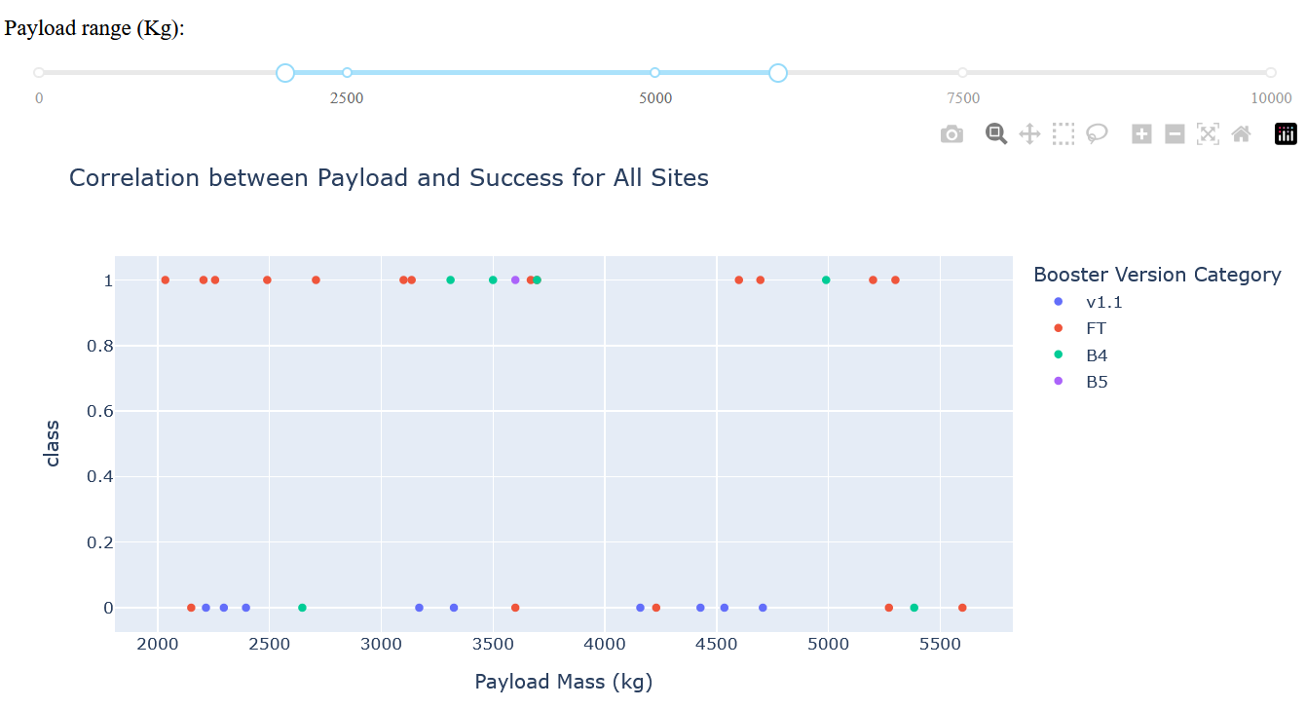
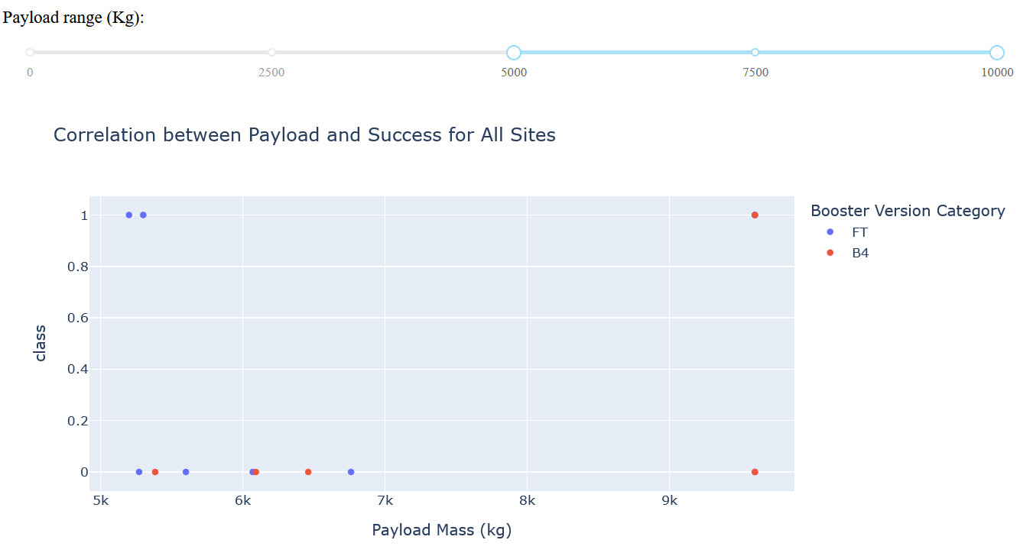
Intermediate and High values for Payload Mass
FT performed best at intermediate and high payloads ranges

Slide 45

Section 5

Slide 46

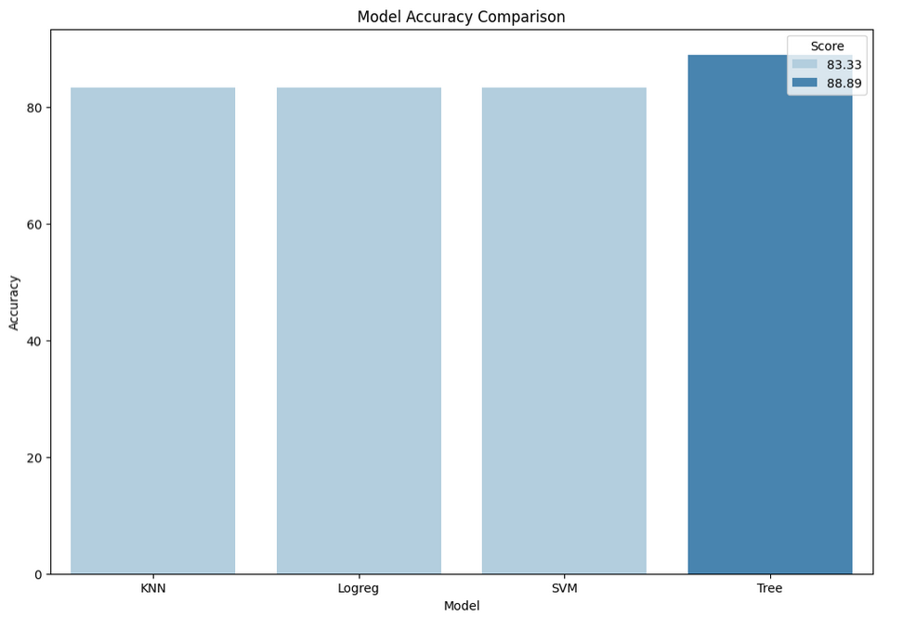
Classification Accuracy
Decision Tree showed better accuracy on test data
Correct classification in 88.89% of data

Slide 47
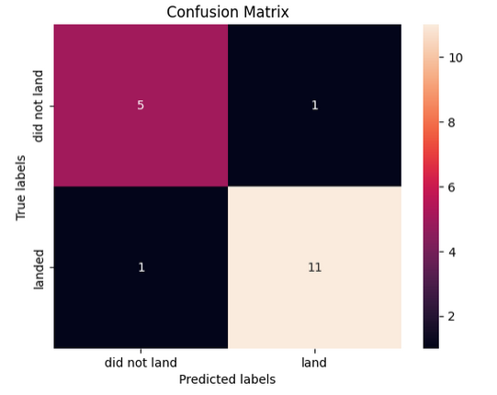

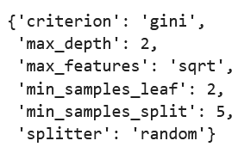
Confusion Matrix
Equally misclassifications for both positive and negative labels

Slide 48



Conclusions
EDA and interactive dashboard helped uncover relationships between key features
e.g. Successful rates improved over Launch Number, indicating that successful launches are correlated with accumulated experience and repeated attempts
Folium maps revealed hidden insights by visualizing spatial patterns in location data
A Decision Tree predictive model was successfully built, achieving an accuracy of 88.89%

Slide 49


